Slide 1

AGRI SHOP
Agri shop is a farming website that helps to our farmer to sell their product on a online platform

Slide 2
PURPOSE OF AGRI SHOP:
Agri shop is a online agriculture website which main purpose is sell their product through online platform.
Agri shop is helps farmers by providing them a large online market to sell their product
Customer can send purchase request and they can purchase product through website
Agri shop is a platform that bring together growers, producers and and value-added vendors to sell on agri shop website

Slide 3
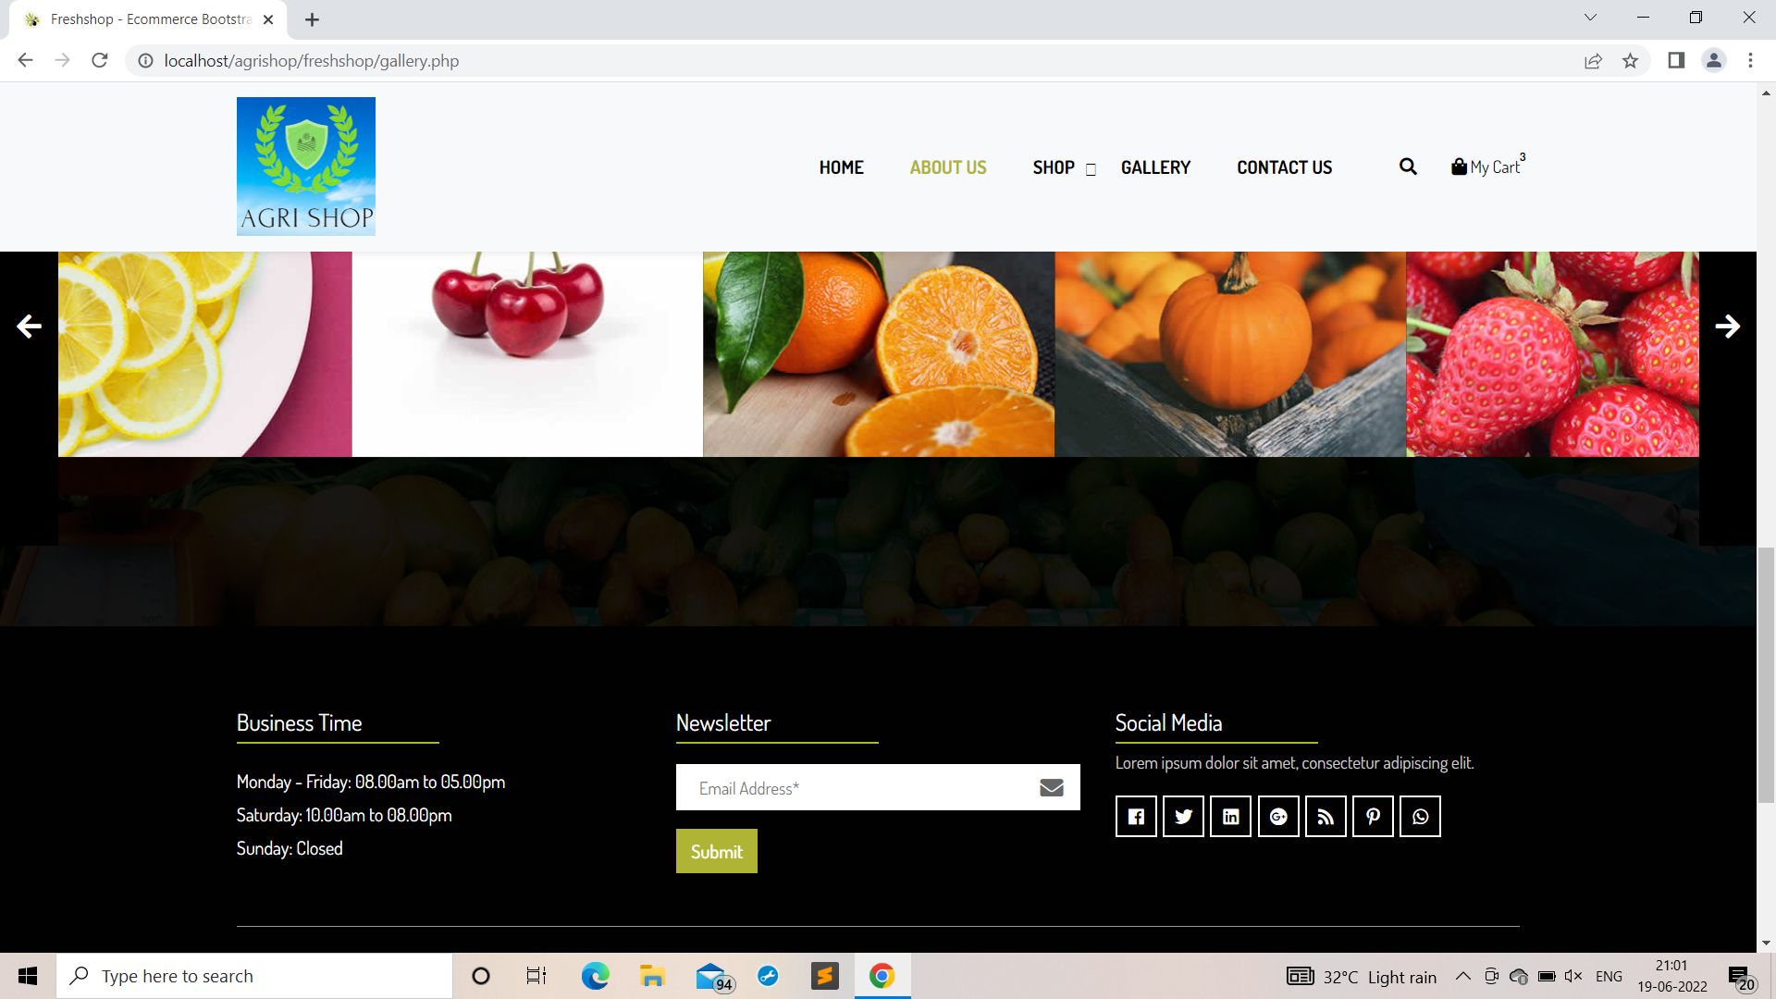

Slide 4
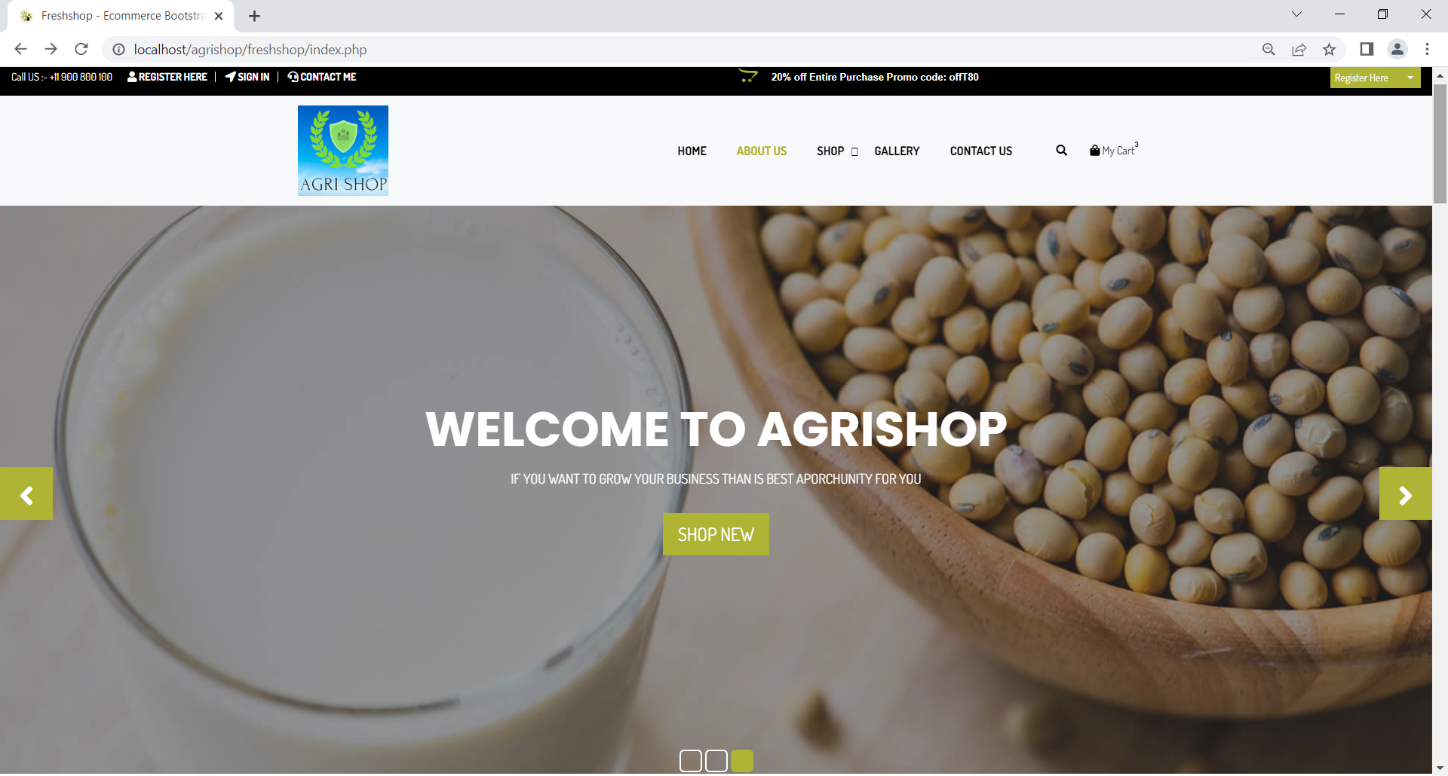

Slide 5
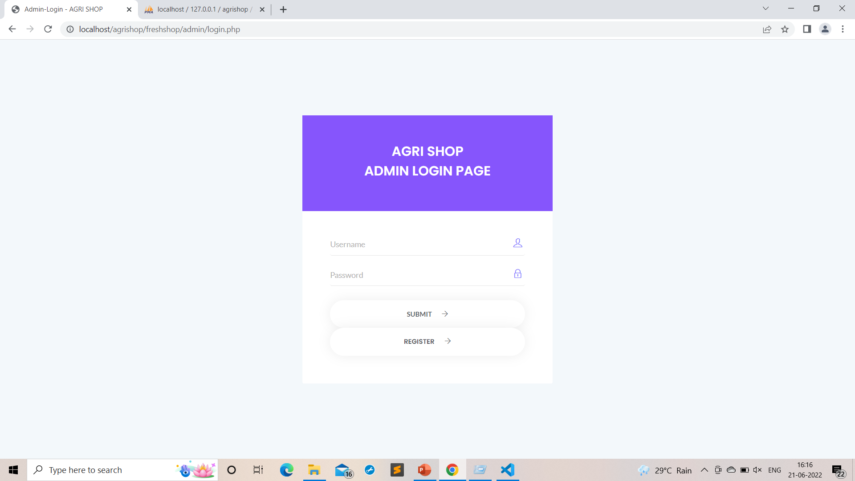

Slide 6
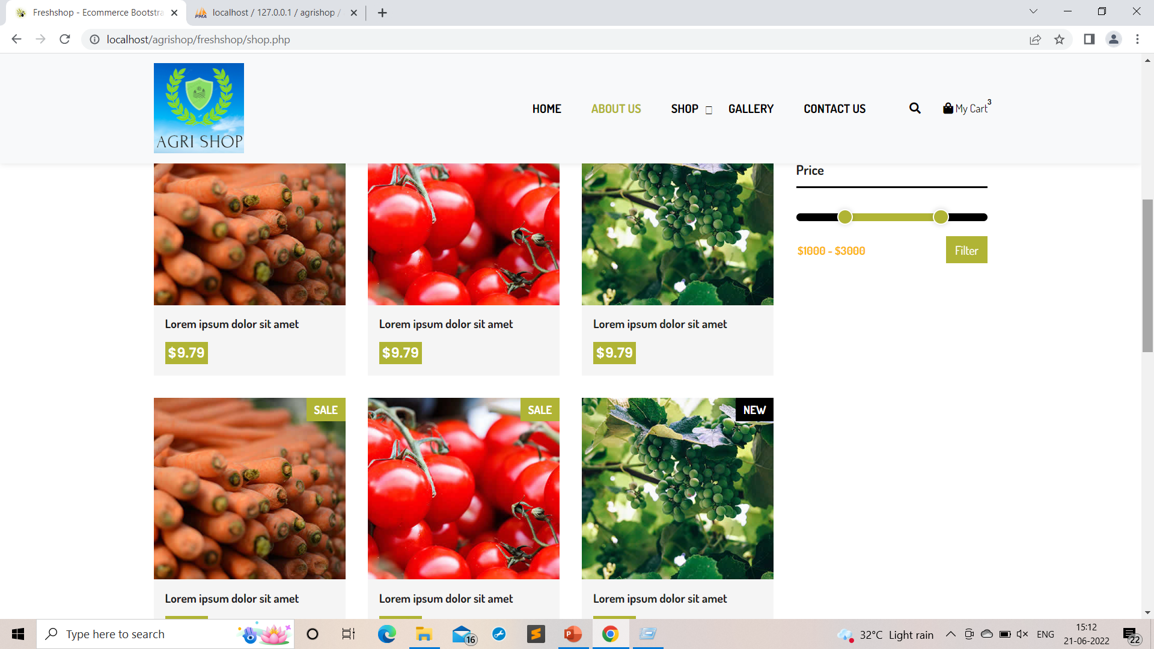

Slide 7
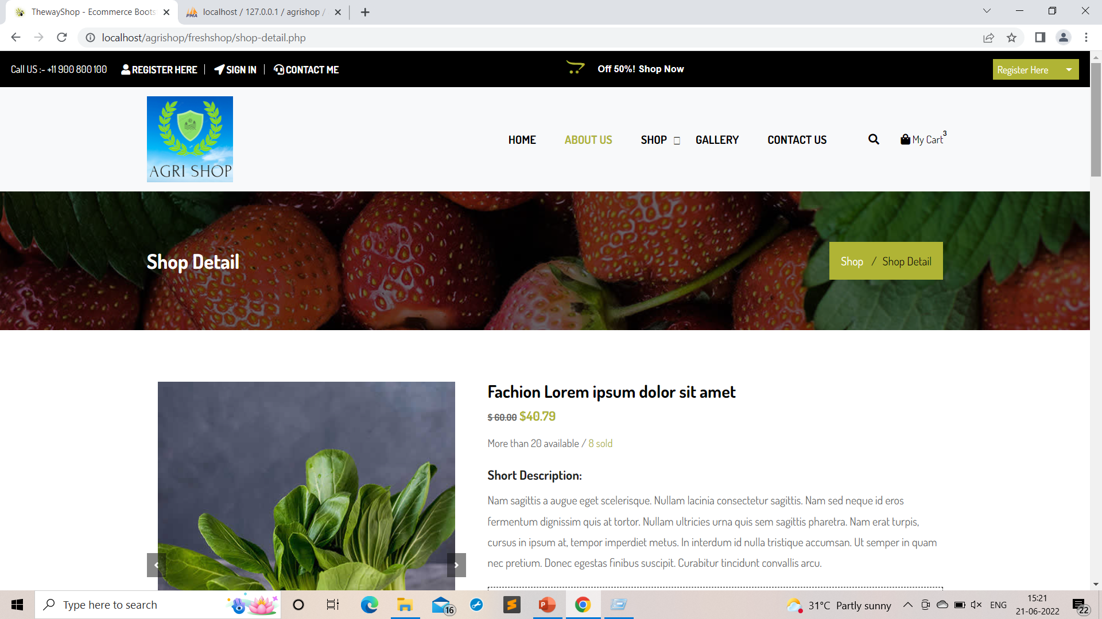

Slide 8
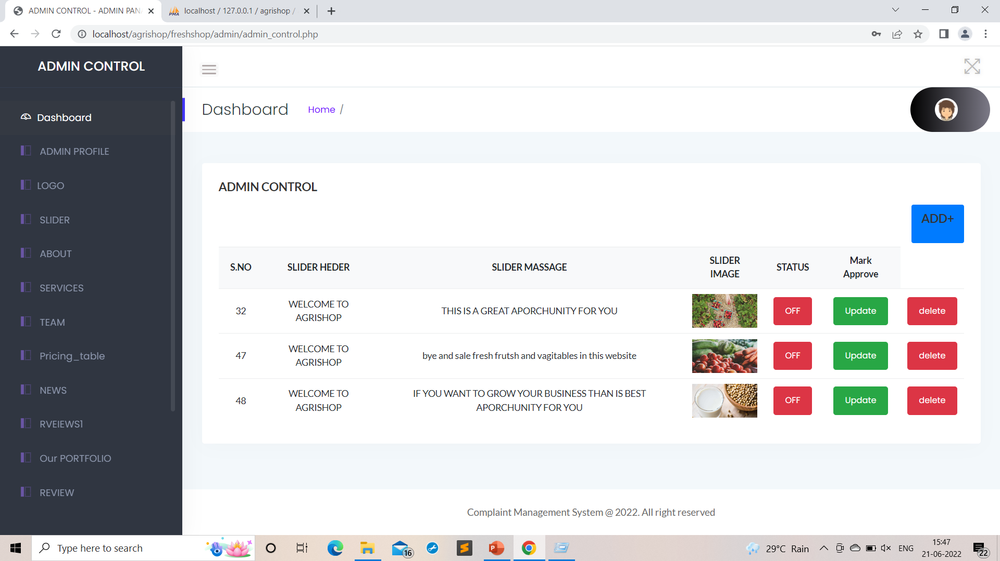

Slide 9
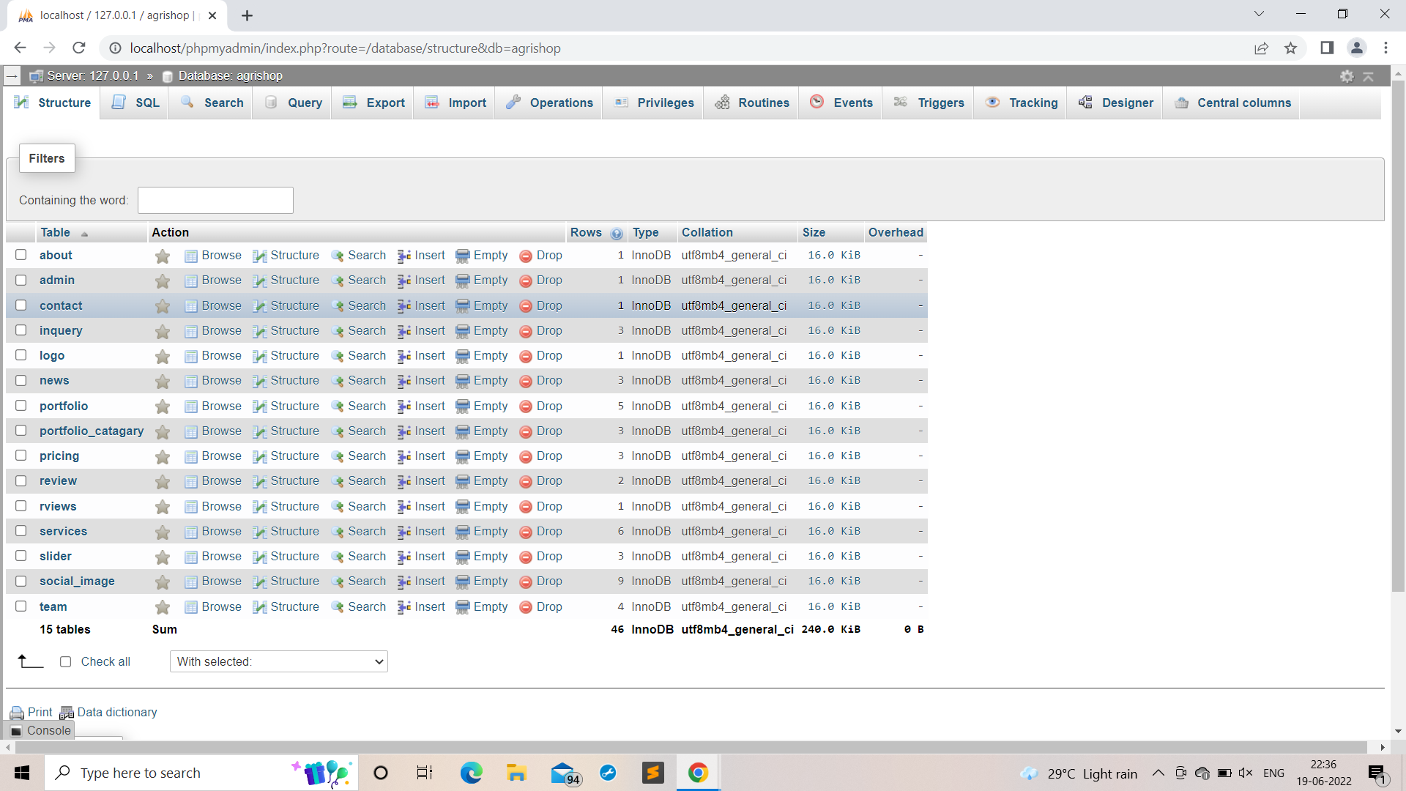

Slide 10

AGRI SHOP
THANK YOU

